Slide 1

Career Choice
Chapter 1, Lesson-1-1
First Element of Personal Finance - Income

Slide 2

Minimum Wage Assignment
Go to google classroom and complete the minimum wage assignment
After Completing The Assignment, fill in the bottom of page 3 of your activity packet.

Slide 3

Review (if Mrs. Vetter is here) Kahoot

Slide 4
When you are Paid
How Often | # of Checks for year?
Weekly
Biweekly (every two weeks)
Bimonthly (twice a month)
Monthly
52 checks
26 Checks
24 Checks
12 Checks
For Salary: divide by number of checks to determine paycheck amount
Example: $36,000 salary with 24 paychecks = $1500 per check, or $3000 a month.

Slide 5
You Try:
If you are paid a salary of $48,000 being paid bi-monthly what is your gross wage per check?
$2,000
If you were paid $48,000 and paid weekly, what is your gross wage for each check?
$923.08

Slide 6
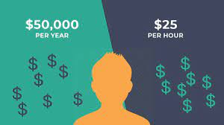
.
For Wages: multiply the hourly wage by number of hours per check
If you work full time at $15 an hour. What is your gross wage for 40 hours
$600 a week
If you get paid every two weeks and work 40 hours per week at $10
$800 every 2 weeks
If you are getting paid bi-weekly working 40 hours per week for $10 per hour, what is your annual wage?
$20,800 per year

Slide 7
Calculate
You Earn commission at 3% for selling a house for $350,000
$10,500
You Earn a base salary of $15 and hour with 3% commission, you worked 40 hours, sold $6,000 in product for the week.
$600 weekly wage + $180 commission
Total of $780

Slide 8
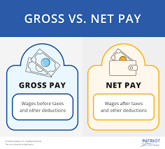
IF Gross per week is $400
Is this the amount of money you have to spend?
Why or Why not?
Because that is gross wage and no taxes have been taken out.
Do not plan your finances around your gross!!!

Slide 9
Types of Unpaid Work
There are a few different types of unpaid work to consider:
Volunteer - Someone who generally works part-time, in service of a company or organization
Being a volunteer generally implies you are not paid
A volunteer is generally someone who wants to be helpful, but doesn’t necessarily want a career in that field

Slide 10
Types of Unpaid Work
Intern - a student or trainee who works, with or without pay, at a trade or occupation in order to gain work experience in a particular field
Can be paid (by wage or stipend) or unpaid
While many internships can lead to a job offer, it is not required.
Apprentice – most often paid – but some unpaid

Slide 11

Quick Write Activity
Based on what you’ve learned, what type of work do you think you are currently most interested in?
Full-Time vs Part-Time?
Paid vs Unpaid?
If paid, hourly wage or salary?
If unpaid, as a volunteer or intern?
Both?
Why do you feel that way?

Slide 12
Assignment – Google Classroom
Complete the Google Assignment Calculating Wage Assignment

